Slide 1
Unit 1 Academic Vocabulary
Analyze | Inference | Proficient | Publish
Cite | Multi-media | Diverse | Academic
Evidence | Collaborate | Produce (ELA) | URL
Citation | Collegial | Presentation | Genre
Fiction | Nonfiction | Audience | Organization
Thesis/Claim | Transitions | Revising | Editing

Slide 2
Definition:
a personal website or web page on which an individual records opinions, links to other sites, etc. on a regular basis.
Synonym: online journal; diary
Visual Example:
Blog
(Noun)
http://tinyurl.com/onbfl6q
How is this word used in an academic setting?
Academically, I might use a blog when I want to argue the ethics in the story “Flowers for Algernon.” In Social Studies I would use a blog to discuss with my classmates my views on historical debates.
How/When would you use this word outside of school?
A blog could be used when I want to share ideas about my creative nail art hobby with others around the world.
By Ms. Denlinger

Slide 3
Definition:
To examine carefully and in detail so as to identify causes, key factors, and possible results
Synonym(s): Scrutinize, Evaluate, Study
Antonym(s): Ignore, Neglect
Visual Example:
http://tinyurl.com/nrwmy26
Analyze
Verb
How is this word used in an academic setting?
This word is used in an academic setting when doing an essay or test, you must make sure you analyze again the work done for errors.
How/When would you use this word outside of school?
You could use this outside of school for a job application, you need to analyze your reasons and key points for the job.
Brandon Espinoza P.3

Slide 4
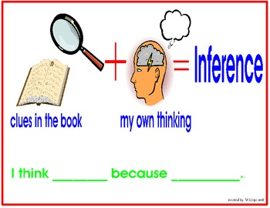
Definition:
A conclusion reached on the basis of evidence and reasoning.
Synonym(s): Assumption & Reasoning
Antonym(s): Fact, Reality, & Truth
Visual Example:
http://tinyurl.com/nkr9ygh
Inference
(Noun)
How/When would you use this word outside of school?
One way you would use the word inference outside of school is when you see that the trash is tipped over and you see that some of the trash is by your dog's bed so you might infer that your dog was the one who tipped over the trash.
How is this word used in an academic setting?
Academically, I might make an inference when a book gives you clues about crime suspects and you make a prediction on who the criminal might be.
Elle Jarecki Period 3

Slide 5
V
I
S
U
A
L
:
http://tinyurl.com/nrcsatg
Definition:
having or showing exceptional knowledge, experience, or skill in a certain goal.
Synonym(s): experienced, professional, competent.
Antonym(s): incompetent, incapable, unskilled.
Proficient
(Adjective)
How is this word used in an academic setting?
Academically, someone who is proficient at a subject, for example, means they have mastered the subject. “I have become a proficient in History and English.”
How/When would you use this word outside of school?
Outside of school, someone who is proficient at sports or gaming, for example, are an expert at sports or gaming. “I am proficient at basketball.”
Katiyana Porter

Slide 6
Definition:
When someone prepares and issues something of theirs for the public to view or buy
Synonym(s): release, produce, publicize, distribute, post, broadcast, reveal, promulgate
Antonym(s):conceal, hide, withhold
Publish
Verb
http://tinyurl.com/pc6sw9y
How is this word used in an academic setting?
Academically, you could publish something to your class if you want the class to read a story you made.
How/When would you use this word outside of school?
You may publish a story about how you visited a foreign country over the summer and how it was like on social media.
Michel Donovan

Slide 7
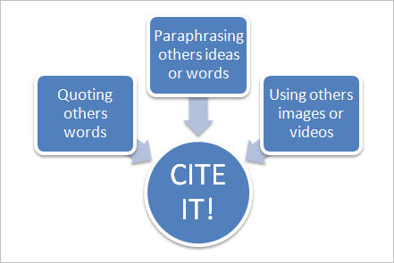
Definition:
to quote (a passage, book, author, etc.)
to mention in support or proof; refer to as an example
Synonym(s): reference, extract, or exemplify
Antonym(s): conceal, withhold
Visual Example:
Cite
(verb)
http://tinyurl.com/mspx8t6
How is this word used in an academic setting?
Academically, this word could be used when a student is writing an essay and needs some evidence to back up his/her claim. They would be citing evidence, as well as citing their source.
How/When would you use this word outside of school?
Outside of school, cite can be used in the same way. For example, if someone was getting arrested the police officer would have to cite the criminals rights.
By Briana Luna Pd.3

Slide 8
Definition:
showing a great deal of differences
Synonym(s): different, multiple, unique
Antonym(s): similar, conforming, identical
Visual Example:
Diverse
(Adjective)
http://tinyurl.com/qdh4y9b
How is this word used in an academic setting?
Diverse can be used in an academic setting by kids being unique and having many ideas for school assignments.
How/When would you use this word outside of school?
I would use this word outside of school when I might be talking about the diversity of the world.
Aliyah Castillo P.5

Slide 9
Definition:
relating to education and scholarships.
Synonym(s):
Educational, instructional; scholastic.
Antonym(s):
Ordinary; Simple
Visual Example:
Academic
(Adjective)
http://tinyurl.com/pm4p24v
How is this word used in an academic setting?
How/When would you use this word outside of school?
Academically, academic can be used in school by stating or relating a sentence to education and school.
Example:
Mark had no academic qualifications to graduate High School.
Academic can be used out of school when explaining the academic’s of a sport, hobby, or knowledge of something.
Example:
Mark showed Sally how much academic work he has put into his artwork for Art Club.
By: Ashlee Fortenbach Pd.2

Slide 10
Definition:
the available body of facts or information indicating whether a belief or proposition is true or valid.
Synonym(s): Proof, verification, information
Antonym(s): Denial, Contradiction, Disproof
Visual Example:
EVIDENCE
(Noun)
http://tinyurl.com/puefu9m
How is this word used in an academic setting?
Academically, I may use evidence when disputing with other classmates in which situation is most valid. I would use evidence in English to site where I got the information.
How/When would you use this word outside of school?
Outside of school I can use evidence when having my sister sign a contract saying to do something for me. The contract being the evidence.
Deija Medina Period 5

Slide 11
Definition:
work jointly on an activity, especially to produce or create something.
Synonym(s): participate, combine, ally
Antonym(s): part, separate
Visual Example :
Collaborate
(Verb)
http://tinyurl.com/prlasx2
How is this word used in an academic setting?
Academically, I might need to collaborate with other classmates when my teacher assigns a project to the class where we have to work in groups. I might also need to collaborate with my teammates whenever we play a certain game during P.E.
How/When would you use this word outside of school?
Some military forces from different countries might need to collaborate to defeat a common enemy or threat.
Isaac Varela Pd.3

Slide 12
Definition:
make (something) using creative or/and mental skills
Synonym(s):
put together, originate, create
Antonym(s):
exterminate
Visual Example:
Prouduce
Verb
http://tinyurl.com/nvjtxud
How is this word used in an academic setting?
The word "produce" is used in a academically setting when you are creating something.An example might be when your teacher assigns you to create a story for a project.
How/When would you use this word outside of school?
The word "produce" is used outside of school when someone is usually making a movie. Another example might be when the owner of a restaurant has to produce the orders for the customers.
By Priscilla Angulo p.5

Slide 13
Definition: A URL is one type of uniform resource identifier;the generic term for all types of names and addresses that refers to objects on the world wide web.
Synonym(s):Web address
Antonym(s): none
Visual Example (must include url link to cite):
http://tinyurl.com/qhktgen
URL
‘’ noun’’
How is this word used in an academic setting?
You can use this word when your doing research and you have to show what your url is or what your web address was when you found info or pictures...
How/When would you use this word outside of school?
i would use this word outside of school when i find things online that interest me and i can tell people to type this certain url in to find it also..
By:Nehemiah Moe, Period 1

Slide 14
Definition:
using more than one medium of expression or communication.:”a multimedia of form”.
Synonym(s): Mixed Media,Intermedia, Interactive media
Antonym(s): books, newspaper
Visual Example (must include url link to cite):
Multi-media
http://tinyurl.com/nqrazct
How is this word used in an academic setting?
Multi-media is used in academic setting to express your knowledge in multiple ways,solve problems, revise your own work and to build your own knowledge.
Adjective
How/When would you use this word outside of school?
You would use the word outside of the classroom setting in things such as social media, movie and fashion industry.
Isabel Castillo P.1

Slide 15
Definition:
Relating to or involving shared responsibility, as among a group or colleagues.
Synonym(s):Team; Coordinated
Antonym(s): Divided; unhelpful
Visual Example:
http://tinyurl.com/qxb735t
Collegial
Adjective
How is this word used in an academic setting?
We can use the word Collegial in an academic setting by when we get into groups during class and talk about our project or responsibilities. (Collegial)
How/When would you use this word outside of school?
You would use the word Collegial out of school when you get a job and you talk to your colleagues about your job or you are talking to a group sharing information or responsibilities.
by:Madison Hamilton pd.5

Slide 16
Definition:
the proffering or giving of something to someone, especially as part of a formal ceremony.
Synonym(s): awarding; giving, granting
Antonym(s): concealment; hiding
Visual Example:
Presentation
(Noun)
http://tinyurl.com/qd2cab7
How is this word used in an academic setting?
Academically I might use a presentation when I want to present a project to my classmates at school. In History I would use a presentation to help my classmates learn about George Washington.
How/When would you use this word outside of school?
I would use this word outside of school at a job meeting presenting a powerpoint about a new product.
By Luis Delgadillo Pd.3

Slide 17
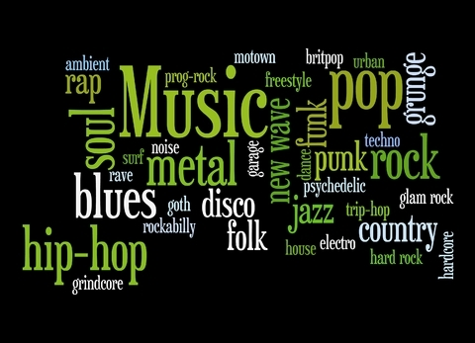
Definition:
A category of artistic composition, as in music or literature, characterized by similarities in form, style, or subject matter
Synonym(s): category, class, classification, group
Antonyms): None
Antonym(s):
Visual Example
Genre
(Noun)
http://tinyurl.com/ob7m7km
How is this word used in an academic setting?
Genre can be used in academics in history class because you learn about American history, World history, and Ancient history.
How/When would you use this word outside of school?
Genre can be used outside of school with music because there are different parts of music like hip pop/rap, classical, and county.
Charles Luhm P.2

Slide 18
Definition:
The class of literature comprising works of imaginative narration.
Synonym(s): Fantasy, Fable, Legend, Tale
Antonym(s): Reality, Fact
Visual Example (must include url link to cite):
Fiction
(Noun)
http://tinyurl.com/p3ovokz
How is this word used in an academic
setting?
Academically, I might use fiction in school for a narrative story, or doing a project about a made-up person or thing.
How/When would you use this word outside of school?
Outside of school I use fiction for reading books, also I watch movies such as the movie “Home”.
Fabiola Velazco pd.5

Slide 19
Definition:
writing that is based on facts, real events, and real people, such as history
Synonym(s):
textbook; dictionary; thesaurus
Antonym(s):
fiction; fairytale
http://tinyurl.com/ox2qyvt
V
I
S
U
A
L
Non- Fiction
(noun)
How is this word used in an academic setting?
Academically, this word can be as a genere of a story. It can also be used as Narriative Non- Fiction, for example Reflective Writing which is when the writer shares his thoughts about a personal expierence.
How/When would you use this word outside of school?
Not only will you see nonfiction in school, but you will see it when you’re reading a blog or even watching a documentary.
Tyra Ramil Period 3

Slide 20
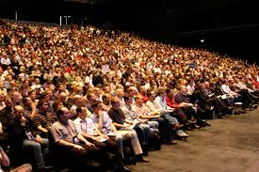
Definition:
the assembled spectators or listeners at a public event, such as a play, movie, concert, or meeting.
Synonym(s): Spectators, Listeners, Viewers
Antonym(s): disruptive
Visual Example :
http://tinyurl.com/ojqkflk
Audience
(Noun)
How is this word used in an academic setting?
In language Arts you might have a presentation in class and students will be the audience. The students with be the audience because they are listening to one person.
How/When would you use this word outside of school?
You would use this word outside of school because whenever you go watch someone perform somewhere you are considered an audience. When you’re out of school you might go to a museum to watch a play.
By Samantha Sanchez p.4

Slide 21
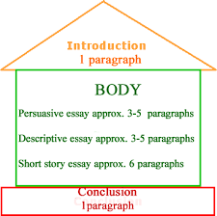
Definition:
The act of arranging something into a specific order.
Synonym(s): planning, arrangement, manage
Antonym(s): disorganized, chaotic, messy
V
I
S
U
A
L
Organization
(NOUN)
http://tinyurl.com/qdzmylc
How is this word used in an academic setting?
Academically, organization would be needed when I am writing an essay. An essay has the organizational pattern of an introduction, body, and conclusion.
How/When would you use this word outside of school?
Outside of school, organization would be needed when I need to plan something important like an event. I would need to organize carefully in order for everything to be done on time.
Ms. Denlinger

Slide 22
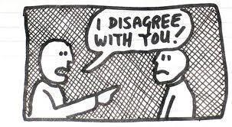
Definition:
A statement or theory that is put forward to be maintained or proved.
Synonym(s): idea; assumption; argument
Antonym(s): unreasonable
Visual Example (must include url link to cite):
Thesis/Claim
Noun
http://tinyurl.com/px4lsap
How is this word used in an academic setting?
Academically, a thesis or claim can be used while writing an argument essay. Or also by talking to someone when disagreeing on something.
How/When would you use this word outside of school?
A thesis or claim could be used when you disagree with someone at home like your parents, or your siblings, and you’re trying to prove something to them. Or it could be used when you are writing a paper for homework.
Jada Cabrera per:2

Slide 23
Definition:
the process of changing from one state or condition to another
Synonym(s):
change, metamorphosis, transformation
Antonym(s): conclusion, end
Visual Example (must include url link to cite):
http://tinyurl.com/omwwymc
Transitions
(noun)
How is this word used in an academic setting?
We use transitions a lot in school such as, essays summaries and other works. It helps us build up each paragraphs.
How/When would you use this word outside of school?
We would use this word outside of school when we have job applications, college applications or any school work related. It is a proper way to build up writing.
Giovanna Silva Period 4

Slide 24
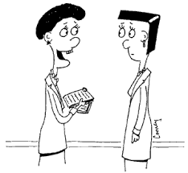
Definition: to reconsider or reread work done previously to improve one’s knowledge of a subject.
Synonym(s): amend, correct, review, modify👍
Antonym(s): ignore, worsen, ruin😒
👀Visual Example:
You should change this because...
Revising
(Verb)
How is this word used in an academic setting📚?
Academically, in Language Arts, you can be revising a peer’s essay by pointing out key points that they may be missing from their paper or ways in which they can improve the organization of their paper.
How/When would you use this word outside of School?
Outside of school, you can be revising a friend’s food blog post to make sure he/she’s post sounds cool and interesting yet professional.🍣🍔🍦
Picture Credits:
http://tinyurl.com/pdtxoca
By Gabbie Agriam P.3
http://tinyurl.com/oo3hvht
http://tinyurl.com/pgmbymg

Slide 25
Definition:
Prepare for publication by correcting,condensing,or otherwise modifying it.
Synonym(s):Correct,check
Antonym(s): Disorder, disarrange
http://tinyurl.com/pkqbjtf
Editing
(Verb)
How is this word used in an academic setting?
Editing is used in an academic setting when you write a story, and you find misspelled words and you change them, that’s editing.
How/When would you use this word outside of school?
You can use editing outside of school when you are drawing and you’re looking for mistakes and if you find one you can erase it and make it better, that’s editing.
By Julian Sandoval p.1

